Slide 1

Linux Network Defense Evasion (Part 2)
Aqeeb Hussain – Offensive Security Tactics For Linux Professionals
Notes:
Welcome everyone to the second part of Linux Network Defence Evasion in this penetration testing course.

Slide 2
Recap
IPTables Firewall Enumeration
Network Reconnaissance Techniques Using IPv6 Addressing
Bypassing IPTables and VLAN Hopping with IPv6
Notes:
Before jumping into this presentation, let’s have a recap of what has been covered in this section of “network defence evasion” already.
We have discussed how to enumerate open ports from the external perimeter with the aim of bypassing potential egress filters in addition to seeing which ports could potentially be open based on an active firewall in place. In particular, we look at how to target IPTables implementations of firewalls in this course.
We then spoke about discovering link local IPv6 addresses of hosts on the internal network which we would move onto using offensively by evading firewall rules placed on the IPv4 channel.
We also looked at hopping VLANs using IPv6 accessing management switches from userland due to misconfigurations.

Slide 3
What’s New?
Current Methods Of Payload Delivery
Detection Considerations
Living Off The Land Tactics (LOTL)
Fileless Payload Delivery
Notes:
Now moving onto what’s new in part 2…
We’ll be taking a step back and looking at what actions we should take as attackers once we gain initial access into a network. From that point you generally want to escalate privileges which does involve use of malicious binaries which are written by yourself or someone else. So we’ll be looking at the current methods of how you can deliver these payloads into the internal network.
We’ll then move onto the considerations of how you can possibly get detected with these methods followed by a brief discussion on Living off the land tactics.
Finally, we’ll be looking into payload dropper delivery methods also known as fileless payload delivery.

Slide 4

Current Methods of Payload Delivery
Notes:
Starting off with the current methods of payload delivery. How do we deliver payloads generally?

Slide 5
Current methods
Payload downloaded remotely via HTTP(S) servers using wget, curl
Payload delivered via SCP (Subset of SSH)
Payload delivered via FTP server
Payload delivered via RSYNC
Payload delivered via network socket using Python, Perl, Netcat
Notes:
There are many ways a payload can be passed in. We can use HTTP servers or store our payloads on GitHub or any other storage solutions from which we can pull the payload.
Some other ways can involve using SCP since discussed before. We have initial access, in our case this access would be via SSH which could allow us to use SCP. If we gained access via a vulnerability from another port we can attempt adding our public keys to connect via SSH to use SCP.
If this is not successful, we can easily resort to other methods such FTP, RSYNC or even use encrypted/unencrypted network sockets in which we’d pass the payload into the internal network.

Slide 6

What Do All Delivery Methods Have In Common?
Notes:
Now let’s have a short reflection. What do all of these delivery methods have in common? What is something they all end up doing in the end?

Slide 7
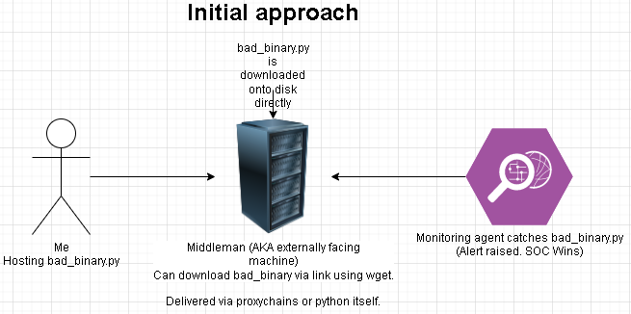
Notes:
The answer is that regardless of what we do, we still drop our binary into the target disk which leaves a trace. Bare in mind, you’re always going to leave a trace as an attacker. The fact that you’ve connected is a trace itself. But it’s a case of how big our trace is and how deep it is. Can it lead to us being detected? In this case, if you’re dropping malicious binaries on a target disk and if there’s a SOC monitoring agent installed or even other tools used for scanning the device, we increase our risk of detection.

Slide 8

Detection Measures
HIDS (Host Intrusion Detection System) – Wazuh
SOC Analysts/Active Monitoring – Outsourced Contractors/In-house defenses
Scanning tools to detect unusual files (RKHunter)
Notes:
A little further discussion on the detection measures.
We can be open to any of these or none of these. As an offensive security specialist you need to anticipate that your target could be well defended and be prepared to overcome these potential defences to remain under the radar. Since if you’re conducting a red team engagement, getting caught is not a part of the deal, stealth is a must.
Some of the defences in question can be a host intrusion detection system. Also known as a HIDS to shorten the long pronunciation, a good HIDS example is Wazuh which could detect your malicious binary on the target system.
Your target could also have SOC capabilities which could be outsourced contractors monitoring traffic and activity on the system or any other active detection systems which could raise the alarm due to a binary being dropped on the network.
Another example which is used even today is rkhunter, yet another legacy tool which could catch our userland malicious binaries which are used for privilege escalation opportunities. We don’t want to get burnt before we can reach root so the intention is to avoid dropping binaries on the target disk.

Slide 9
Living Off The Land Tactics
Living off the land: Using available resources in the target environment to craft makeshift tools for exploitation.
Using built-in programming languages to create offensive scripts instead of using ready-made tools.
Using the targets environment against them in a minimalist manner to avoid detection.
You will always leave a trace behind, it’s just a case of how big/deep that trace is?
During LOTL tactics the scripts are dropped onto the disk leaving a bigger trace of attacker presence in the network.
Notes:
As discussed before about living off the land. Living off the land is a step taken to ensure that we only use resources available to us on the target system. The purpose of this approach? To prevent actively installing any off-the-shelf tools on the target environment and to keep a minimised presence. As a result, we may make use of programming languages which are built into the target system which ultimately means we are dropping binaries on the disk. As discussed before we will leave a trace no matter what, but whilst we live off the land we need to ensure that we keep our trace minimal as we progress in our attack.

Slide 10
How Do We OVERCOME This?
Notes:
So yet another time for reflection and some thought. How do we overcome this?
One of the solutions be using SSH SOCKS proxies to interact with internal network hosts using ready made tools but we host everything on our machine to prevent any installations being made on the target disk.
But what if we want to run something which has to be launched directly on the target filesystem? SOCKS proxies are more designed for network based tools and can help us to achieve things such as port scanning, banner grabbing and connecting to network services hosted as HTTP(S).
When it comes to privilege escalation based payloads, SOCKS proxies alone can’t be of help to us. So what do we do? Any ideas before we move to the solution?

Slide 11
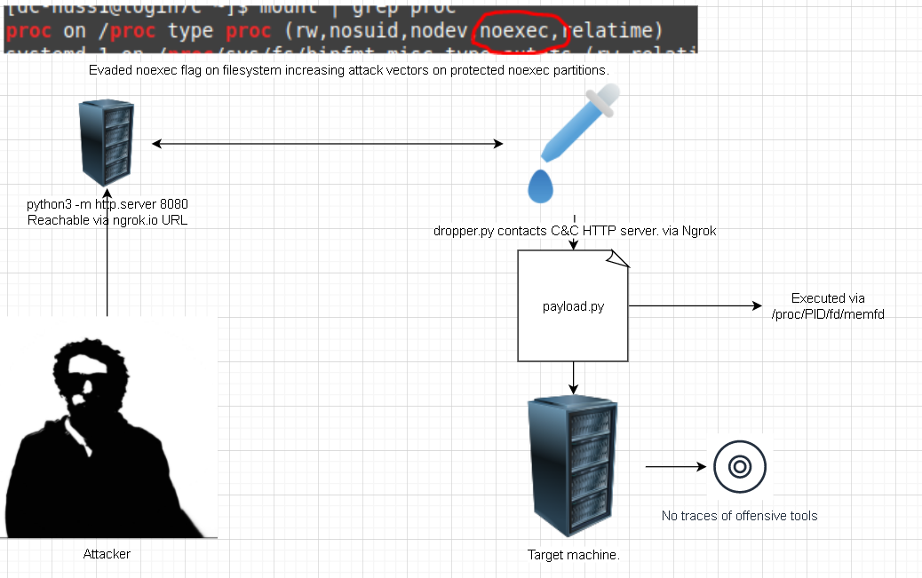
Fileless payload delivery
Notes:
We will conduct fileless payload delivery. The whole idea of fileless payload delivery is what it says on the tin. We deliver a payload to our target but we ensure not to drop any files on the target system. The diagram you see right now gives you an overview of how this attack works, in the coming slides; lets dissect this attack further and see how it all comes together.

Slide 12
How Does Fileless Malware Delivery Work?
Fileless payloads are called via kernel system call known as: memfd_create()
Memfd_create as quoted from documentation is: “memfd_create() creates an anonymous file and returns a file descriptor that refers to it. The file behaves like a regular file, and so can be modified, truncated, memory-mapped, and so on. However, unlike a regular file, it lives in RAM and has a volatile backing storage. Once all references to the file are dropped, it is automatically released. Anonymous memory is used for all backing pages of the file.”
Notes:
What makes fileless payload delivery possible in the first place is a kernel system call known as memfd_create.
Quoting directly from the documentation we can see that we receive a file descriptor as a reference to our file and we can use this file just as we would with any other file on the file system meaning we can read/write it in addition to execution.
The catch here is that once you remove all references or even reboot your machine, the file is gone. There are no traces of the file since it is all working in RAM and never stored on the core disk of the target disk.

Slide 13
How Does Fileless Malware Delivery Work?
Fileless payloads can be called using any programming language and can use different methods such as:
Code packing – Packing a binary into an executable to deliver to the target using SSH pipes (Possible in Perl)
Hosting the payload via HTTP server on a C&C (Command & Control) which we connect to using a dropper payload
Notes:
Moving onto some of the delivery methods now.
We can launch fileless payloads in different ways. One way can be to pack a binary in small chunks into a dropper payload which will deliver the malware to the target using SSH pipes. This is possible in languages such as Perl and it can support elf binaries.
Alternatively we can use HTTP C&C servers on the outside which we can contact using our dropper payload which leverages memfd_create syscalls in addition to creating the file we need to launch our payload.

Slide 14
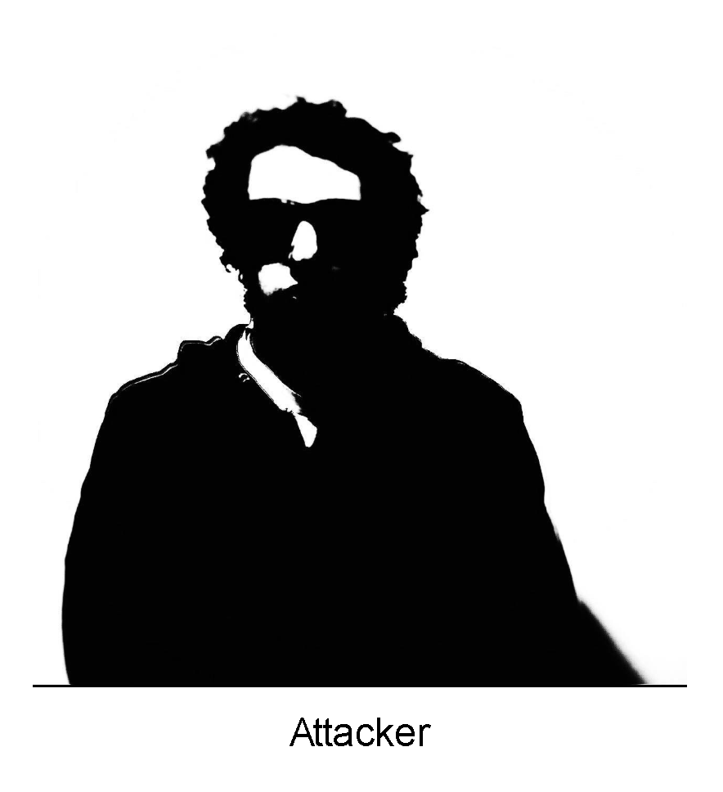
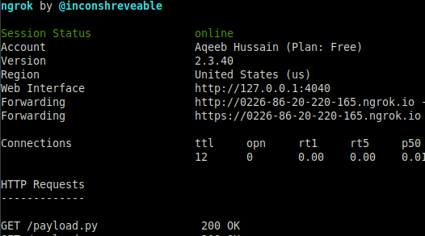
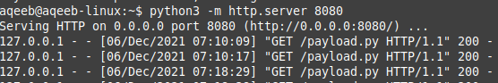
The Attack
Using C&C (Command & Control) machine we establish an HTTP server which will host the payload destined for target.
The method discussed will use NGROK to expose an HTTP server which the target can pull the payload from when execution is required.
Exposing port 8080 via WAN using Ngrok
14

Slide 15
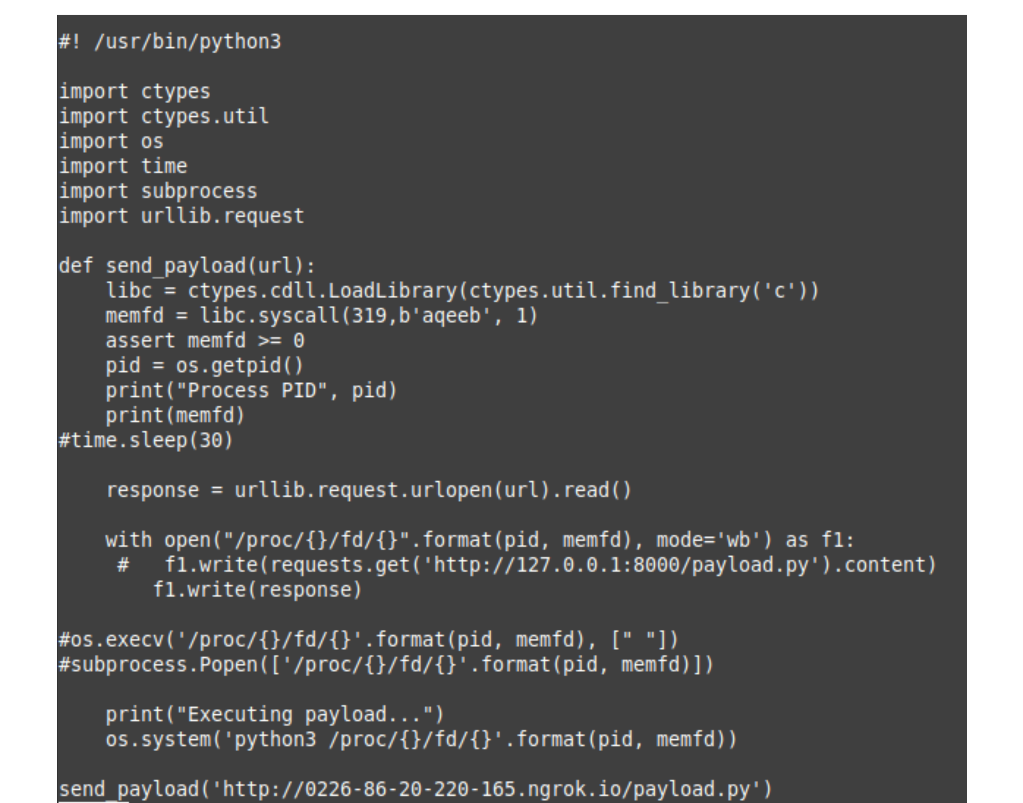
Dropper Payload
Make a memfd syscall and create the file. We also grab the PID
URL pointing to the payload stored on HTTP C&C server
Read the payload data in bytes
Execute our payload (Python payload in this case)
Read the remote payload and write it to /proc with the memfd name and PID
Function call with ngrok based HTTP server containing payload.
15

Slide 16
Dropper Execution
We can’t leave any traces on the target disk so how do we execute our dropper payload?
SSH pipes will deliver our payload from the C&C machine to the target through which we execute the payload using the remote interpreter, in this case it’s Python.
From this point, our dropper executes on the target via SSH pipe which launches our exploit in RAM.

Slide 17
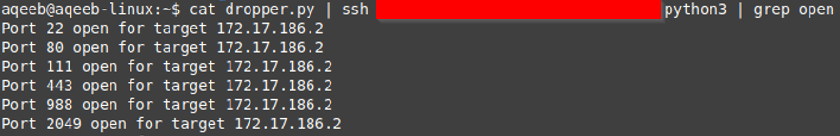
Execution Time!
Using cat we will output the file to stdout and then pipe the output into SSH
We then run our piped payload to a remote python3 instance.

Slide 18
Why use Fileless Payload Delivery?
Using malware dropper methods, HIDS/SOC systems cannot detect any malicious payloads on the target environment which would be left behind during regular LOTL practices of writing malicious scripts on target environment.
Can bypass “noexec” file systems which disallow execution of binaries on the partitions such as “/proc” increasing exploitation surface
All traces of malware execution are erased upon reboot. If we are root, we could easily issue a reboot after cleaning tracks (Shredding relevant log traces/leftover files)

Slide 19

What if the target is an internal host?

Slide 20
The Previous Attack?

Slide 21
Problems with our current approach
The ngrok server cannot be contacted from the edge since we want to send our payload directly to an internal machine.
We are not root, we can’t manipulate ip routes to get an internet connection.
We could deliver the payload to the edge machine but then we have left a payload on the network which defeats fileless delivery.

Slide 22

What do we do now?

Slide 23
Solution: Reverse SSH Tunnel using Jump Host
From attacker machine: “ssh -fN -R 8080:localhost:8080 -J (middleman) (target)”
Background the tunnel in addition to no command execution and remote port forwarding
Connect to the target host by first making a ssh connection to
the jump host described by destination and then establishing a TCP forwarding to the ultimate destination from there.
Local Python HTTP server on port 8080 is sent to internal machine on target network.

Slide 24
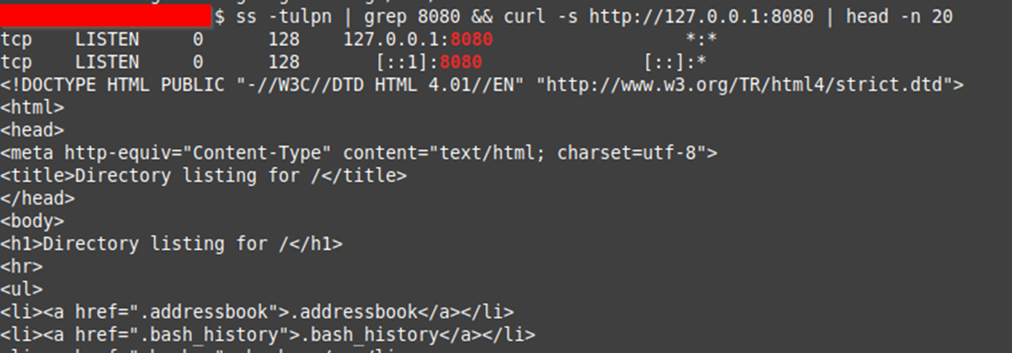
Verify presence of HTTP Server
The port 8080 is available on the target.
A curl check verifies it is our HTTP server.

Slide 25
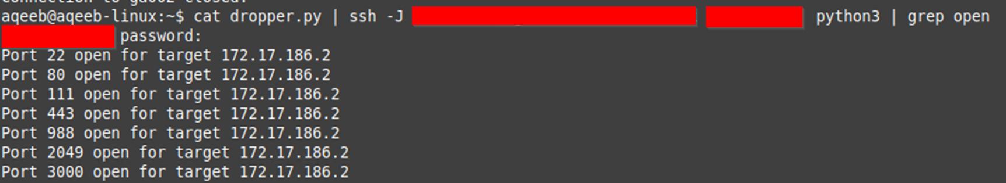
Execution of Reverse SSH tunnel and payload

Slide 26
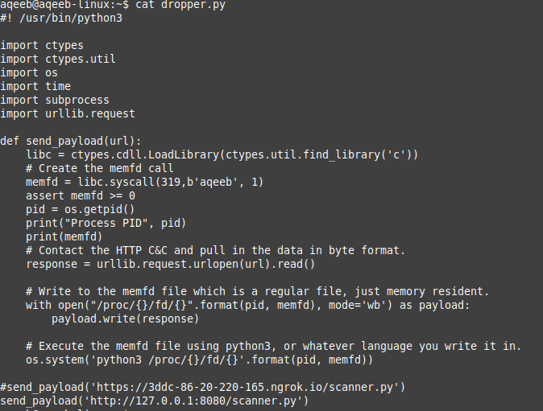
Dropper payload (internal attack)
Payload will connect to an internally available server.
Change our IP to 127.0.0.1 since server will be tunnelled in via SSH

Slide 27
How do we protect ourselves as defenders?

Slide 28
How do we protect ourselves as defenders?
From an offensive perspective, the use of fileless payloads is a step forward but it has its flaws.
This solution may be invisible to the target disk however active payloads can’t hide from the network.
This can allow the use of monitoring tools such as “lsof” and “ps” to be able to spot any unusual processes on the filesystem in addition to any active network connections from reverse shells.
The next step ahead from an offensive perspective is to achieve privilege escalation from this point and develop rootkits stored in RAM to hide further traces.

Slide 29

Questions?

Slide 30
Next Talk: Linux Privilege Escalation

Slide 31
Thank you!
Instructor: Aqeeb Hussain
GitHub: https://github.com/aqeebhussain122/hpc-offensive-security

